Slide 2
Database Concurrency Control
1 Purpose of Concurrency Control
  To enforce Isolation (through mutual exclusion) among conflicting transactions.
  To preserve database consistency through consistency preserving execution of transactions.
  To resolve read-write and write-write conflicts.
Example:
  In concurrent execution environment if T1 conflicts with T2 over a data item A, then the existing concurrency control decides if T1 or T2 should get the A and if the other transaction is rolled-back or waits.
Slide 22-<number>

Slide 3
Database Concurrency Control
Two-Phase Locking Techniques
  Locking is an operation which secures
    (a) permission to Read
    (b) permission to Write a data item for a transaction.
  Example:
    Lock (X). Data item X is locked in behalf of the requesting transaction.
  Unlocking is an operation which removes these permissions from the data item.
  Example:
    Unlock (X): Data item X is made available to all other transactions.
  Lock and Unlock are Atomic operations.
Slide 22-<number>

Slide 4
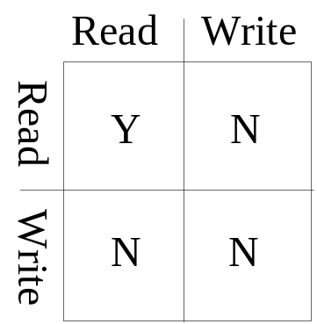
Database Concurrency Control
Two-Phase Locking Techniques: Essential components
  Two locks modes:
    (a) shared (read) (b) exclusive (write).
  Shared mode: shared lock (X)
    More than one transaction can apply share lock on X for reading its value but no write lock can be applied on X by any other transaction.
  Exclusive mode: Write lock (X)
    Only one write lock on X can exist at any time and no shared lock can be applied by any other transaction on X.
  Conflict matrix
Slide 22-<number>

Slide 5
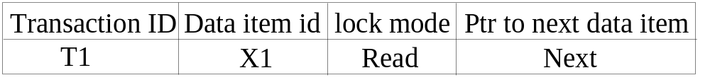
Database Concurrency Control
Two-Phase Locking Techniques: Essential components
  Lock Manager:
    Managing locks on data items.
  Lock table:
    Lock manager uses it to store the identify of transaction locking a data item, the data item, lock mode and pointer to the next data item locked. One simple way to implement a lock table is through linked list.
Slide 22-<number>

Slide 6
Database Concurrency Control
Two-Phase Locking Techniques: Essential components
  Database requires that all transactions should be well-formed. A transaction is well-formed if:
    It must lock the data item before it reads or writes to it.
    It must not lock an already locked data items and it must not try to unlock a free data item.
Slide 22-<number>

Slide 7
Database Concurrency Control
Two-Phase Locking Techniques: Essential components
  The following code performs the lock operation:
  B: if LOCK (X) = 0 (*item is unlocked*)
  then LOCK (X) ← 1 (*lock the item*)
  else begin
  wait (until lock (X) = 0) and
  the lock manager wakes up the transaction);
  goto B
  end;
Slide 22-<number>

Slide 8
Database Concurrency Control
Two-Phase Locking Techniques: Essential components
  The following code performs the unlock operation:
  LOCK (X) ← 0 (*unlock the item*)
  if any transactions are waiting then
  wake up one of the waiting the transactions;
Slide 22-<number>

Slide 9
Database Concurrency Control
Two-Phase Locking Techniques: Essential components
  The following code performs the read operation:
B: if LOCK (X) = “unlocked” then
  begin LOCK (X) ← “read-locked”;
  no_of_reads (X) ← 1;
  end
  else if LOCK (X) = “read-locked” then
  no_of_reads (X) ← no_of_reads (X) +1
  else begin wait (until LOCK (X) = “unlocked” and
  the lock manager wakes up the transaction);
  go to B
  end;
Slide 22-<number>

Slide 10
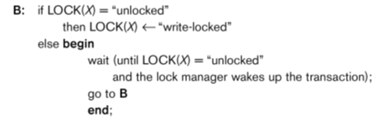
Database Concurrency Control
Two-Phase Locking Techniques: Essential components
  The following code performs the write lock operation:
Slide 22-<number>

Slide 11
Database Concurrency Control
Two-Phase Locking Techniques: Essential components
  The following code performs the unlock operation:
if LOCK (X) = “write-locked” then
  begin LOCK (X) ← “unlocked”;
  wakes up one of the transactions, if any
  end
  else if LOCK (X) ← “read-locked” then
  begin
  no_of_reads (X) ← no_of_reads (X) -1
  if no_of_reads (X) = 0 then
  begin
  LOCK (X) = “unlocked”;
  wake up one of the transactions, if any
  end
  end;
Slide 22-<number>

Slide 12
Database Concurrency Control
Two-Phase Locking Techniques: Essential components
Lock conversion
  Lock upgrade: existing read lock to write lock
if Ti has a read-lock (X) and Tj has no read-lock (X) (i ≠ j) then
  convert read-lock (X) to write-lock (X)
  else
  force Ti to wait until Tj unlocks X
  Lock downgrade: existing write lock to read lock
  Ti has a write-lock (X) (*no transaction can have any lock on X*)
  convert write-lock (X) to read-lock (X)
Slide 22-<number>

Slide 13
Database Concurrency Control
Two-Phase Locking Techniques: The algorithm
Two Phases:
  (a) Locking (Growing)
  (b) Unlocking (Shrinking).
Locking (Growing) Phase:
  A transaction applies locks (read or write) on desired data items one at a time.
Unlocking (Shrinking) Phase:
  A transaction unlocks its locked data items one at a time.
Requirement:
  For a transaction these two phases must be mutually exclusively, that is, during locking phase unlocking phase must not start and during unlocking phase locking phase must not begin.
Slide 22-<number>

Slide 14
Database Concurrency Control
Two-Phase Locking Techniques: The algorithm
T1 T2 Result
read_lock (Y); read_lock (X); Initial values: X=20; Y=30
read_item (Y); read_item (X); Result of serial execution
unlock (Y); unlock (X); T1 followed by T2
write_lock (X); Write_lock (Y); X=50, Y=80.
read_item (X); read_item (Y); Result of serial execution
X:=X+Y; Y:=X+Y; T2 followed by T1
write_item (X); write_item (Y); X=70, Y=50
unlock (X); unlock (Y);
Slide 22-<number>

Slide 15
Database Concurrency Control
Two-Phase Locking Techniques: The algorithm
T1 T2 Result
read_lock (Y); X=50; Y=50
read_item (Y); Nonserializable because it.
unlock (Y); violated two-phase policy.
read_lock (X);
read_item (X);
unlock (X);
write_lock (Y);
read_item (Y);
Y:=X+Y;
write_item (Y);
unlock (Y);
write_lock (X);
read_item (X);
X:=X+Y;
write_item (X);
unlock (X);
Time
Slide 22-<number>

Slide 16
Database Concurrency Control
Two-Phase Locking Techniques: The algorithm
T’1 T’2
read_lock (Y); read_lock (X); T1 and T2 follow two-phase
read_item (Y); read_item (X); policy but they are subject to
write_lock (X); Write_lock (Y); deadlock, which must be
unlock (Y); unlock (X); dealt with.
read_item (X); read_item (Y);
X:=X+Y; Y:=X+Y;
write_item (X); write_item (Y);
unlock (X); unlock (Y);
Slide 22-<number>

Slide 17
Database Concurrency Control
Two-Phase Locking Techniques: The algorithm
Two-phase policy generates two locking algorithms
  (a) Basic
  (b) Conservative
Basic 2PL:
  Transaction locks data items incrementally. This may cause deadlock which is dealt with.
Conservative 2PL:
A transaction must lock all its items before starting execution. If any item it needs is not available, it locks no items and tries again later. Conservative 2PL has no deadlocks since no lock requests are issued once transaction execution starts.
Strict 2PL:
All items that are write locked by a transaction are not released (unlocked) until after the transaction commits. This is the most commonly used two-phase locking algorithm, and ensures strict schedules (for recoverability).
Slide 22-<number>

Slide 18
Database Concurrency Control
Dealing with Deadlock and Starvation
  Deadlock
T’1 T’2
read_lock (Y); T1 and T2 did follow two-phase
read_item (Y); policy but they are deadlock
read_lock (X);
read_item (Y);
write_lock (X);
(waits for X) write_lock (Y);
(waits for Y)
  Deadlock (T’1 and T’2)
Slide 22-<number>

Slide 19
Database Concurrency Control
Dealing with Deadlock and Starvation
Deadlock prevention
  A transaction locks all data items it refers to before it begins execution.
  This way of locking prevents deadlock since a transaction never waits for a data item.
  The conservative two-phase locking uses this approach.
Slide 22-<number>

Slide 20
Database Concurrency Control
1. Deadlock detection and resolution
In this approach, deadlocks are allowed to happen. The system maintains a wait-for graph for detecting cycles. If a cycle exists, then one transaction involved in the cycle is selected (victim) and rolled-back (aborted).
A wait-for graph contains a node for each transaction. When a transaction (say Ti) is blocked because it requests an item X held by another transaction Tj in conflicting mode, a directed edge is created from Ti to Tj (Ti is waiting on Tj to unlock the item). The system checks for cycles; if a cycle exists, a state of deadlock is detected.
Slide 22-<number>

Slide 21
Database Concurrency Control
Dealing with Deadlock and Starvation
Deadlock avoidance
  There are many variations of two-phase locking algorithm.
  Some avoid deadlock by not letting the cycle to complete.
  That is as soon as the algorithm discovers that blocking a transaction is likely to create a cycle, it rolls back the transaction.
  Wound-Wait and Wait-Die algorithms use timestamps to avoid deadlocks by rolling-back victim.
Slide 22-<number>

Slide 22
Database Concurrency Control
Dealing with Deadlock and Starvation
Starvation
  Starvation occurs when a particular transaction consistently waits or restarted and never gets a chance to proceed further.
  In a deadlock resolution it is possible that the same transaction may consistently be selected as victim and rolled-back.
  This limitation is inherent in all priority-based scheduling mechanisms.
  In Wound-Wait scheme a younger transaction may always be wounded (aborted) by a long running older transaction which may create starvation.
Slide 22-<number>

Slide 23
Database Concurrency Control
Timestamp based concurrency control algorithm
Timestamp
  A monotonically increasing variable (integer) indicating the age of an operation or a transaction. A larger timestamp value indicates a more recent event or operation.
  Timestamp based algorithm uses timestamp to serialize the execution of concurrent transactions.
Slide 22-<number>

Slide 24
Database Concurrency Control
Timestamp based concurrency control algorithm
Basic Timestamp Ordering
  1. Transaction T issues a write_item(X) operation:
    If read_TS(X) > TS(T) or if write_TS(X) > TS(T), then an younger transaction has already read the data item so abort and roll-back T and reject the operation.
    If the condition in part (a) does not exist, then execute write_item(X) of T and set write_TS(X) to TS(T).
  2. Transaction T issues a read_item(X) operation:
    If write_TS(X) > TS(T), then an younger transaction has already written to the data item so abort and roll-back T and reject the operation.
    If write_TS(X) ≤ TS(T), then execute read_item(X) of T and set read_TS(X) to the larger of TS(T) and the current read_TS(X).
Slide 22-<number>

Slide 25
Database Concurrency Control
Timestamp based concurrency control algorithm
Strict Timestamp Ordering
  1. Transaction T issues a write_item(X) operation:
    If TS(T) > read_TS(X), then delay T until the transaction T’ that wrote or read X has terminated (committed or aborted).
  2. Transaction T issues a read_item(X) operation:
    If TS(T) > write_TS(X), then delay T until the transaction T’ that wrote or read X has terminated (committed or aborted).
Slide 22-<number>

Slide 26
Database Concurrency Control
Timestamp based concurrency control algorithm
Thomas’s Write Rule
  If read_TS(X) > TS(T) then abort and roll-back T and reject the operation.
  If write_TS(X) > TS(T), then just ignore the write operation and continue execution. This is because the most recent writes counts in case of two consecutive writes.
  If the conditions given in 1 and 2 above do not occur, then execute write_item(X) of T and set write_TS(X) to TS(T).
Slide 22-<number>

Slide 27
Database Concurrency Control
Multiversion concurrency control techniques
  This approach maintains a number of versions of a data item and allocates the right version to a read operation of a transaction. Thus unlike other mechanisms a read operation in this mechanism is never rejected.
  Side effect:
    Significantly more storage (RAM and disk) is required to maintain multiple versions. To check unlimited growth of versions, a garbage collection is run when some criteria is satisfied.
Slide 22-<number>

Slide 28
Database Concurrency Control
Multiversion technique based on timestamp ordering
  This approach maintains a number of versions of a data item and allocates the right version to a read operation of a transaction.
    Thus unlike other mechanisms a read operation in this mechanism is never rejected.
  Side effects: Significantly more storage (RAM and disk) is required to maintain multiple versions. To check unlimited growth of versions, a garbage collection is run when some criteria is satisfied.
Slide 22-<number>

Slide 29
Database Concurrency Control
Multiversion technique based on timestamp ordering
  Assume X1, X2, …, Xn are the version of a data item X created by a write operation of transactions. With each Xi a read_TS (read timestamp) and a write_TS (write timestamp) are associated.
  read_TS(Xi): The read timestamp of Xi is the largest of all the timestamps of transactions that have successfully read version Xi.
  write_TS(Xi): The write timestamp of Xi that wrote the value of version Xi.
  A new version of Xi is created only by a write operation.
Slide 22-<number>

Slide 30
Database Concurrency Control
Multiversion technique based on timestamp ordering
  To ensure serializability, the following two rules are used.
    If transaction T issues write_item (X) and version i of X has the highest write_TS(Xi) of all versions of X that is also less than or equal to TS(T), and read _TS(Xi) > TS(T), then abort and roll-back T; otherwise create a new version Xi and read_TS(X) = write_TS(Xj) = TS(T).
    If transaction T issues read_item (X), find the version i of X that has the highest write_TS(Xi) of all versions of X that is also less than or equal to TS(T), then return the value of Xi to T, and set the value of read _TS(Xi) to the largest of TS(T) and the current read_TS(Xi).
  Rule 2 guarantees that a read will never be rejected.
Slide 22-<number>

Slide 31
Database Concurrency Control
Multiversion Two-Phase Locking Using Certify Locks
Concept
  Allow a transaction T’ to read a data item X while it is write locked by a conflicting transaction T.
  This is accomplished by maintaining two versions of each data item X where one version must always have been written by some committed transaction. This means a write operation always creates a new version of X.
Slide 22-<number>

Slide 32
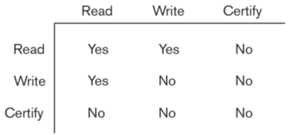
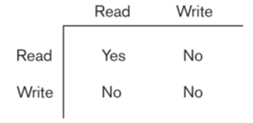
Database Concurrency Control
Multiversion Two-Phase Locking Using Certify Locks
Steps
  X is the committed version of a data item.
  T creates a second version X’ after obtaining a write lock on X.
  Other transactions continue to read X.
  T is ready to commit so it obtains a certify lock on X’.
  The committed version X becomes X’.
  T releases its certify lock on X’, which is X now.
Compatibility tables for
read/write locking scheme read/write/certify locking scheme
Slide 22-<number>

Slide 33
Database Concurrency Control
Multiversion Two-Phase Locking Using Certify Locks
Note:
  In multiversion 2PL read and write operations from conflicting transactions can be processed concurrently.
  This improves concurrency but it may delay transaction commit because of obtaining certify locks on all its writes. It avoids cascading abort but like strict two phase locking scheme conflicting transactions may get deadlocked.
Slide 22-<number>

Slide 34
Database Concurrency Control
Validation (Optimistic) Concurrency Control Schemes
In this technique only at the time of commit serializability is checked and transactions are aborted in case of non-serializable schedules.
Three phases:
  Read phase
  Validation phase
  Write phase
1. Read phase:
  A transaction can read values of committed data items. However, updates are applied only to local copies (versions) of the data items (in database cache).
Slide 22-<number>

Slide 35
Database Concurrency Control
Validation phase: Serializability is checked by determining any conflicts with other concurrent transactions.
  This phase for Ti checks that, for each transaction Tj that is either committed or is in its validation phase, one of the following conditions holds:
    Tj completes its write phase before Ti starts its read phase.
    Ti starts its write phase after Tj completes its write phase, and the read_set(Ti) has no items in common with the write_set(Tj)
    Both read_set(Ti) and write_set(Ti) have no items in common with the write_set(Tj), and Tj completes its read phase before Ti completes its write phase.
    When validating Ti, the first condition is checked first for each transaction Tj, since (1) is the simplest condition to check. If (1) is false for a particular Tj, then (2) is checked and only if (2) is false is (3 ) is checked. If none of these conditions holds for any Tj, the validation fails and Ti is aborted.
Slide 22-<number>

Slide 36
Database Concurrency Control
Validation (Optimistic) Concurrency Control Schemes
3. Write phase: On a successful validation transactions’ updates are applied to the database; otherwise, transactions are restarted.
Slide 22-<number>

Slide 37
Database Concurrency Control
Granularity of data items and Multiple Granularity Locking
A lockable unit of data defines its granularity. Granularity can be coarse (entire database) or it can be fine (a tuple or an attribute of a relation).
Data item granularity significantly affects concurrency control performance. Thus, the degree of concurrency is low for coarse granularity and high for fine granularity.
Example of data item granularity:
  A field of a database record (an attribute of a tuple)
  A database record (a tuple or a relation)
  A disk block
  An entire file
  The entire database
Slide 22-<number>

Slide 38
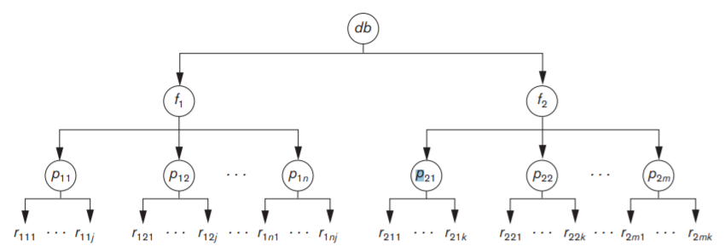
Database Concurrency Control
Granularity of data items and Multiple Granularity Locking
The following diagram illustrates a hierarchy of granularity from coarse (database) to fine (record).
Slide 22-<number>

Slide 39
Database Concurrency Control
Granularity of data items and Multiple Granularity Locking
To manage such hierarchy, in addition to read and write, three additional locking modes, called intention lock modes are defined:
  Intention-shared (IS): indicates that a shared lock(s) will be requested on some descendent nodes(s).
  Intention-exclusive (IX): indicates that an exclusive lock(s) will be requested on some descendent node(s).
  Shared-intention-exclusive (SIX): indicates that the current node is locked in shared mode but an exclusive lock(s) will be requested on some descendent nodes(s).
Slide 22-<number>

Slide 40
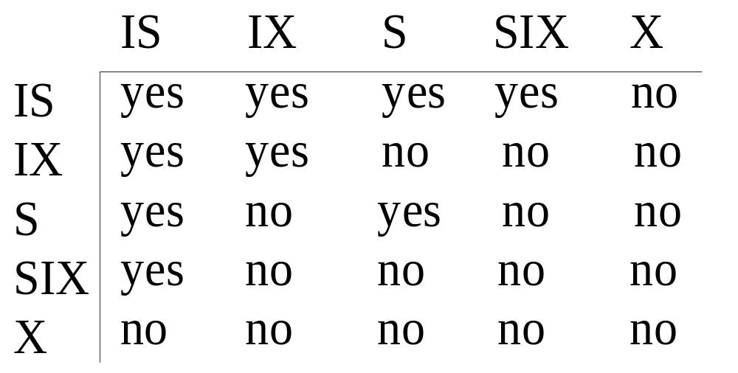
Database Concurrency Control
Granularity of data items and Multiple Granularity Locking
These locks are applied using the following compatibility matrix:
  Intention-shared (IS)
  Intention-exclusive (IX)
  Shared-intention-exclusive (SIX)
Slide 22-<number>

Slide 41
Database Concurrency Control
Granularity of data items and Multiple Granularity Locking
The set of rules which must be followed for producing serializable schedule are
  The lock compatibility must adhere to.
  The root of the tree must be locked first, in any mode..
  A node N can be locked by a transaction T in S or IX mode only if the parent node is already locked by T in either IS or IX mode.
  A node N can be locked by T in X, IX, or SIX mode only if the parent of N is already locked by T in either IX or SIX mode.
  T can lock a node only if it has not unlocked any node (to enforce 2PL policy).
  T can unlock a node, N, only if none of the children of N are currently locked by T.
Slide 22-<number>

Slide 42
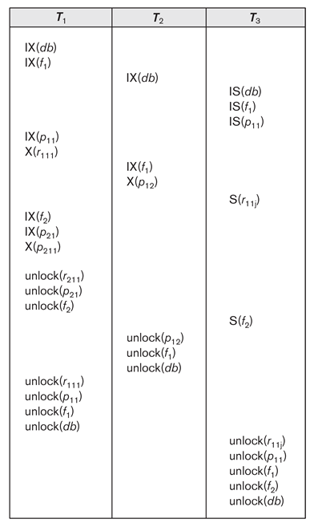
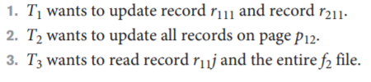
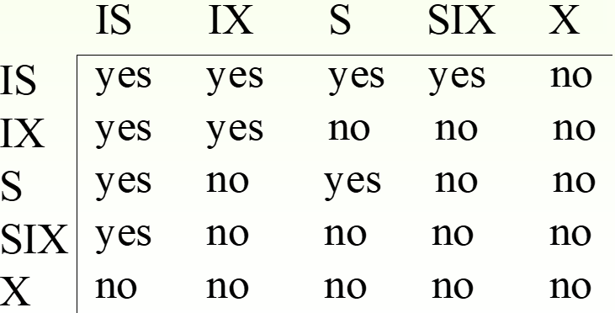
Database Concurrency Control Example
Slide 22-<number>

Slide 43
Summary
Databases Concurrency Control
  Purpose of Concurrency Control
  Two-Phase locking
  Limitations of CCMs
  Index Locking
  Lock Compatibility Matrix
  Lock Granularity
Slide 22-<number>

